Slide 1
Model Projections

Slide 2
What are model projections?
What a model can do
What it doesn’t do
Provide relative information about different scenarios
Pumping
Climate
Resource management
Land use changes
Data worth
Provide absolute answers!!!

Slide 3
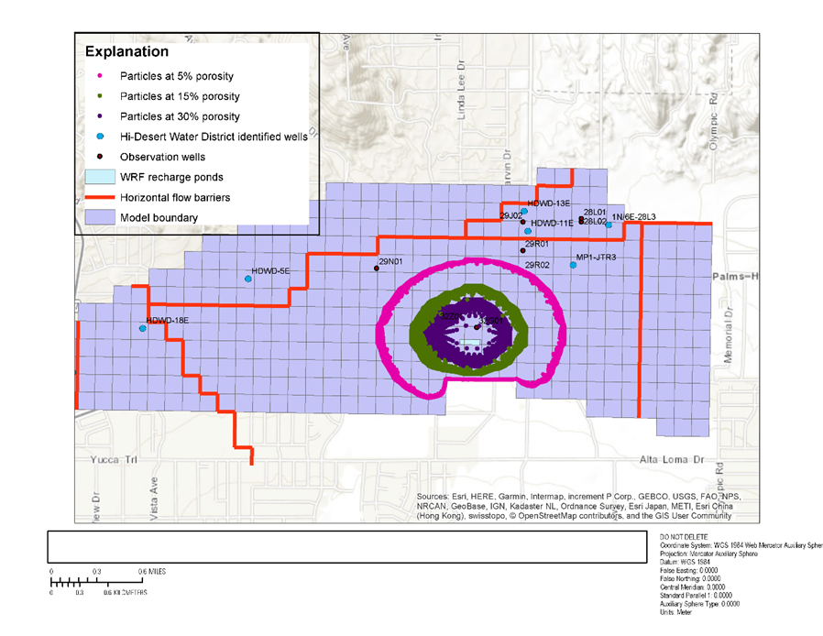
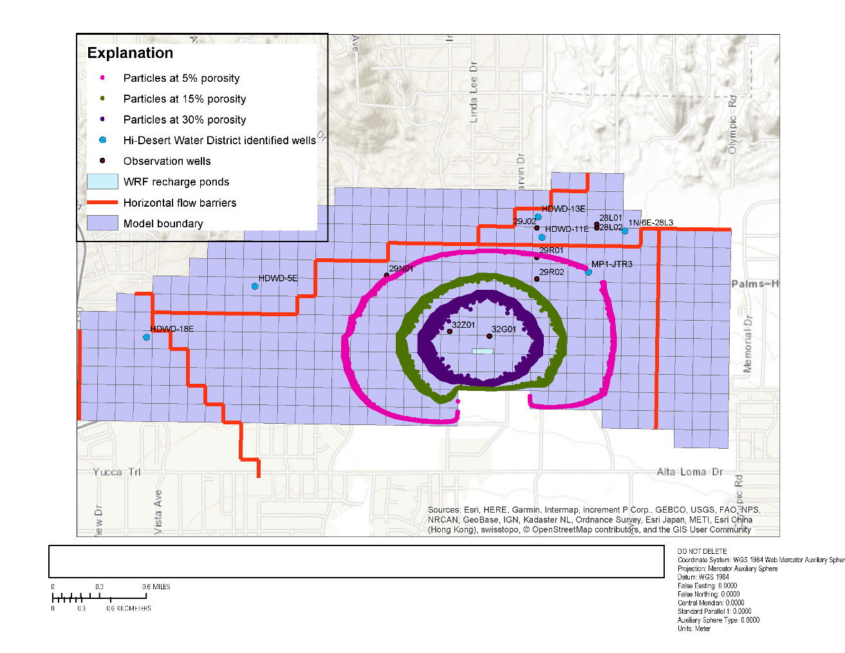
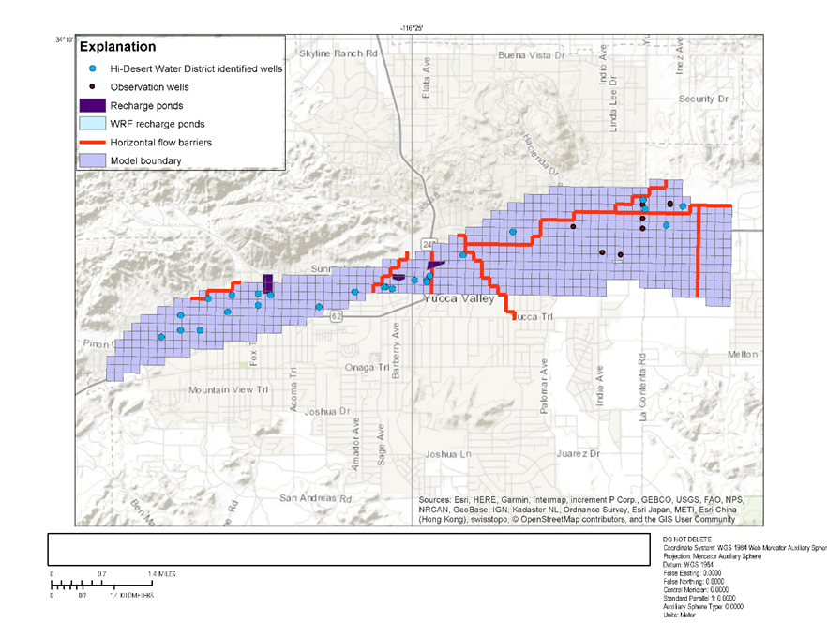
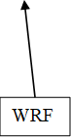
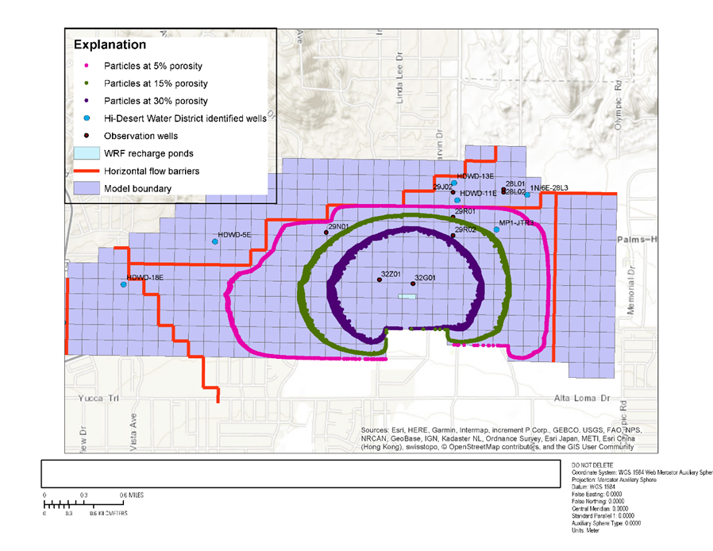
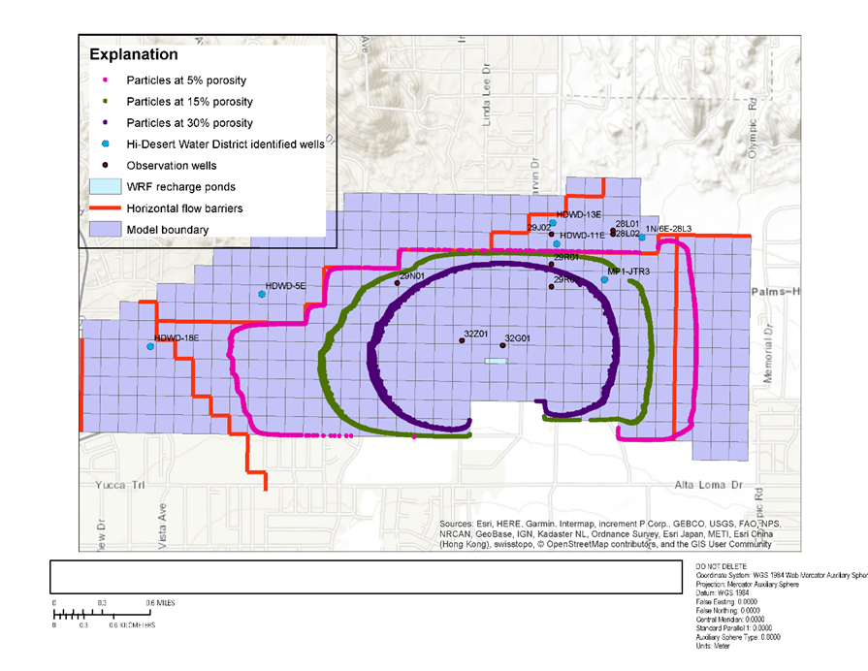
Example: Particle tracking managed aquifer recharge
5 years
10 years
Warren valley, near Joshua Tree
25 years
50 years

Slide 4
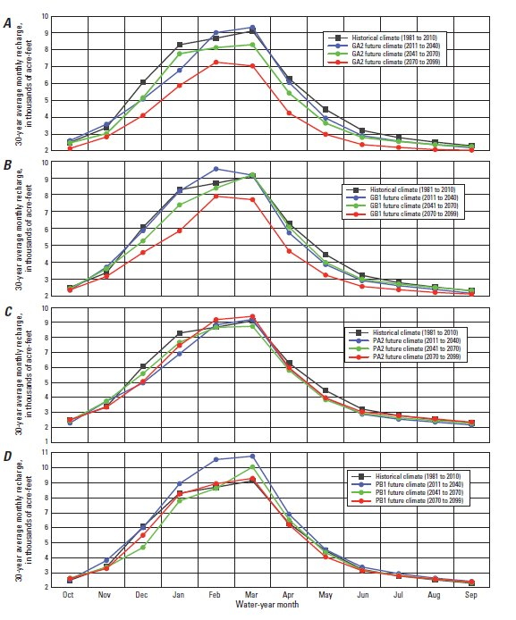
Example: future climate scenarios
Santa Rosa plain, Sonoma County, CA (Woolfenden and Nishikawa, 2014)

Slide 5
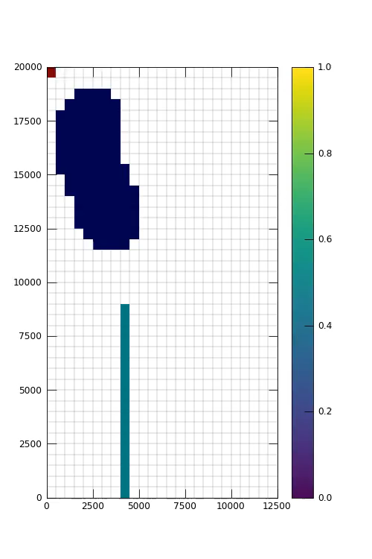
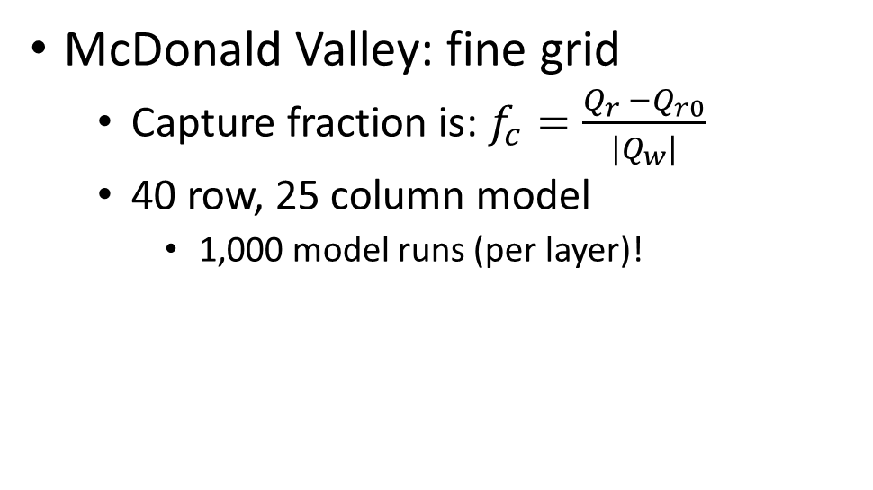
Stream capture fraction
McDonald Valley: fine grid
Capture fraction is: $f_{c}=\frac{Q_{r} −Q_{r0}}{{|Q}_{w}|}$
40 row, 25 column model
1,000 model runs (per layer)!

Slide 6
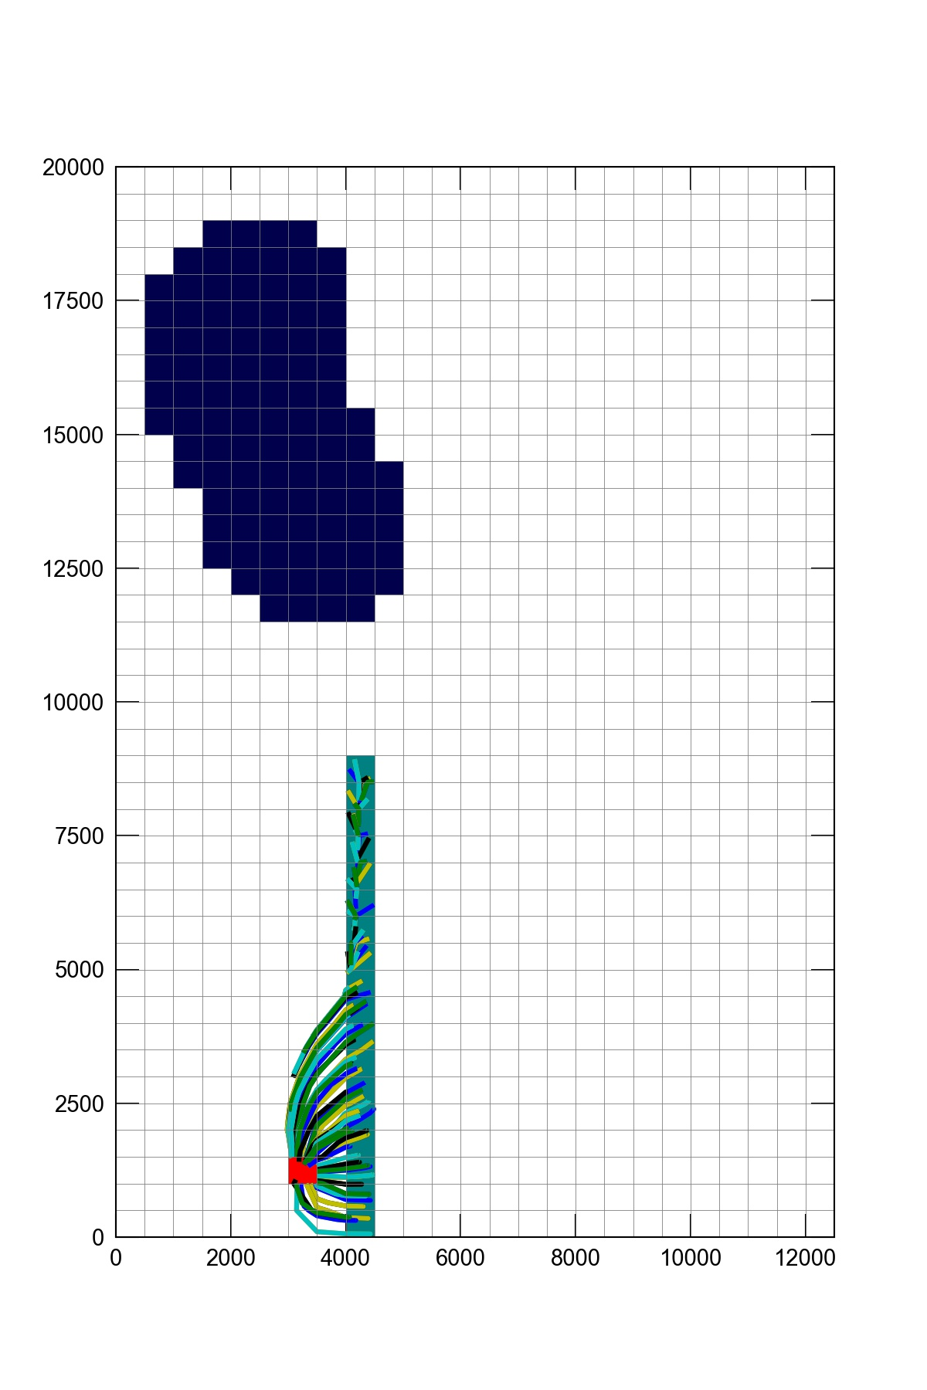
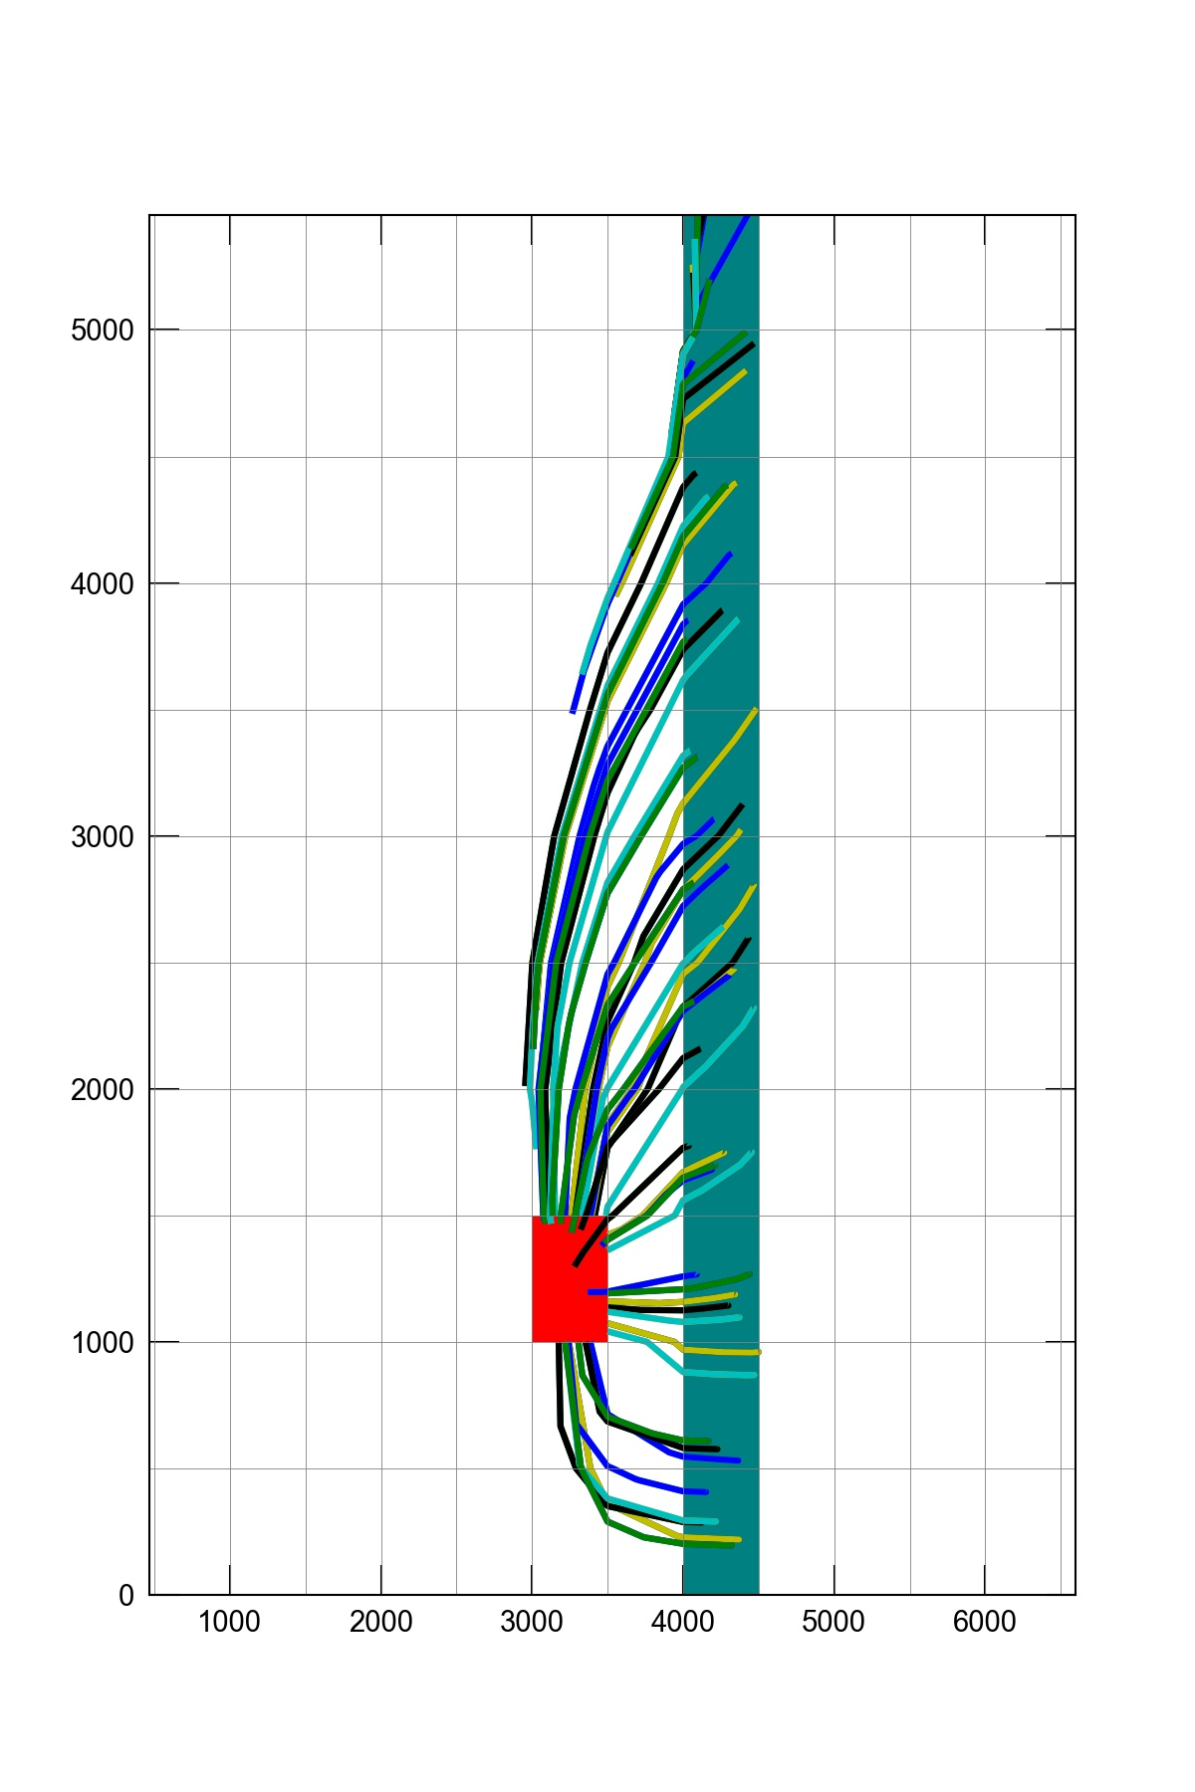
Particle tracking for new/proposed wells
Forward particle tracking
5 particles per cell
Pumping -100000 ft³/d
Model run for 1 year

Slide 7
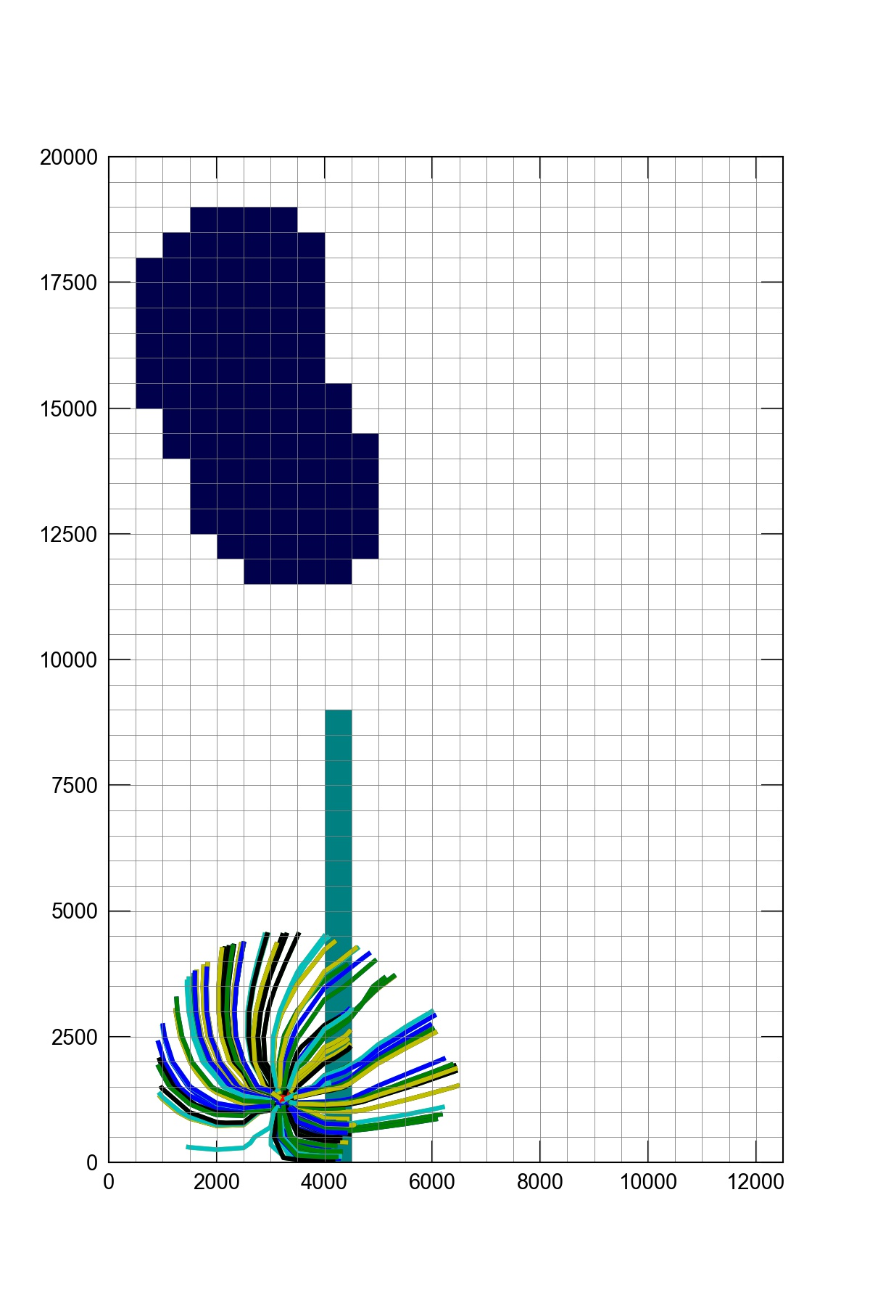
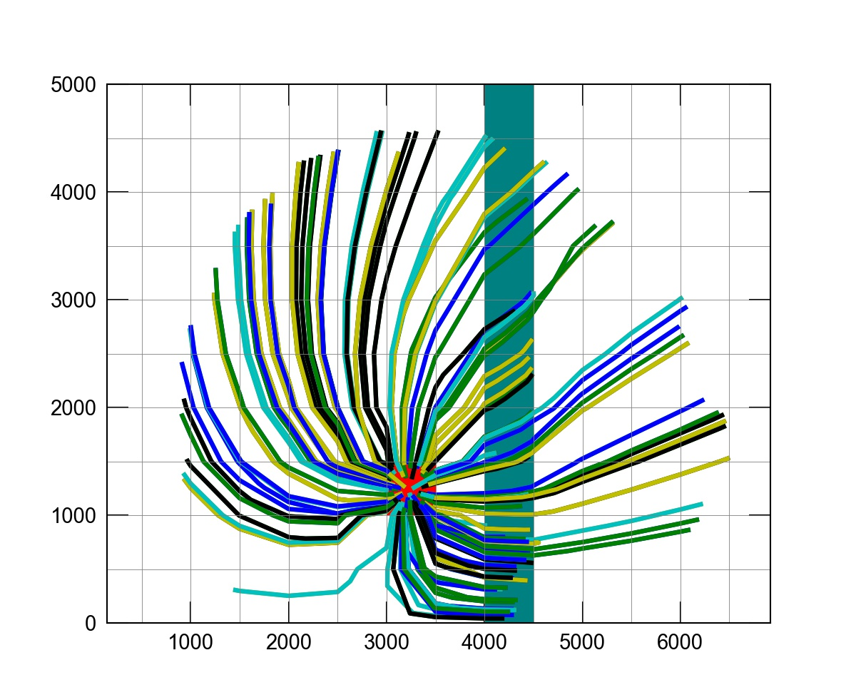
Particle tracking for new wells
Backward particle tracking
100 particles, tracked from well
Pumping -100000 ft³/d
Model run for 1 year

Slide 8
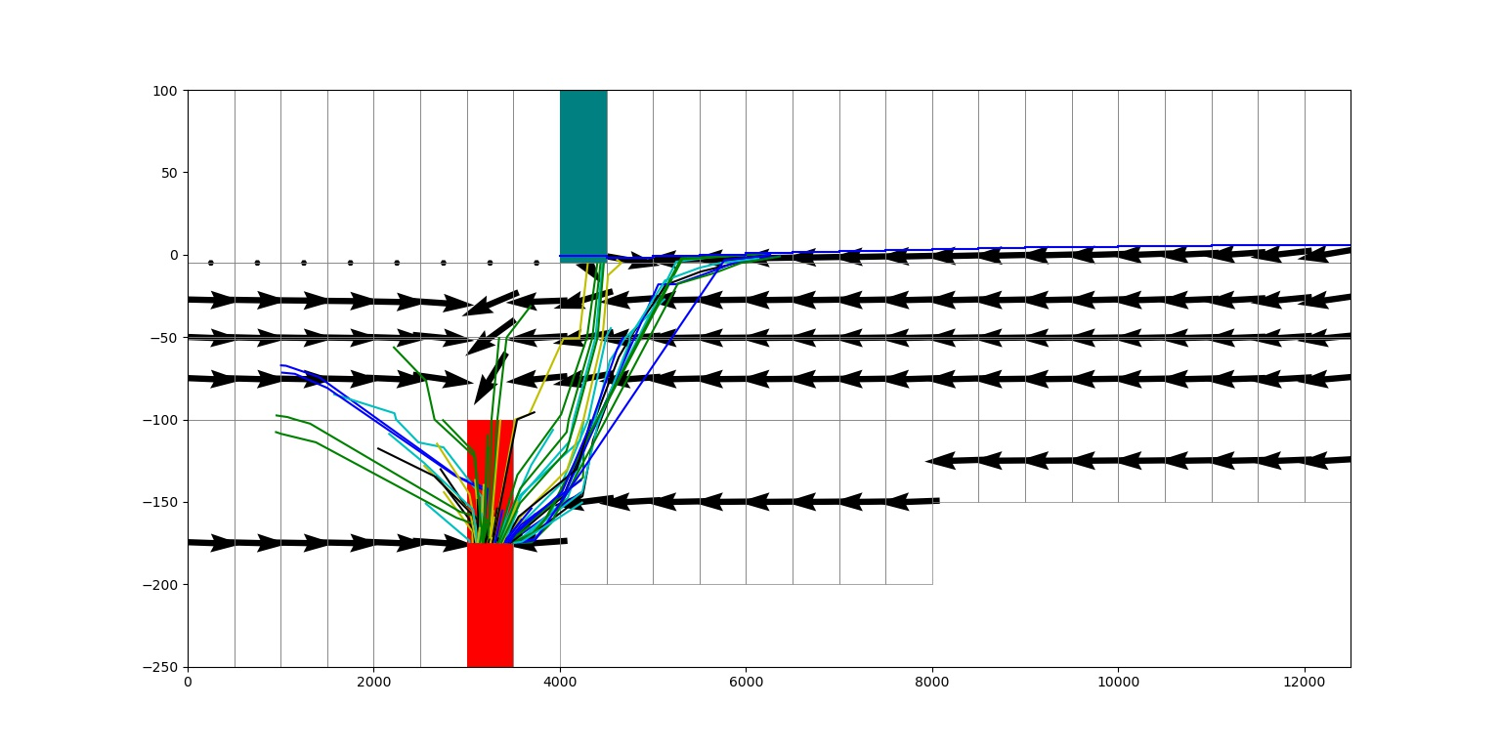
Particle tracking for new wells
Backward particle tracking
100 particles, tracked from well
Pumping -100000 ft³/d
Model run for 1 year

Slide 9
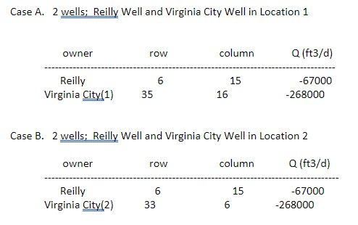
Workshop: Generate model projections
Use your calibrated model to simulate the impact of two different development scenarios

